Slide 1
Frequency Capping in Online Advertising
Moran Feldman
Technion
Joint work with:
Niv Buchbinder, The Open University of Israel
Arpita Ghosh, Yahoo! Research
Joseph (Seffi) Naor, Technion

Slide 2
Outline
Motivations
Competitive Ratio
Models
  Previous models
  Our new model
Our Results
  Reduction to unit frequency caps
  The equal values case
  The general case
Open Problems

Slide 3
Frequency Capping in Online Advertising
Types of online advertising:
  Sponsored search advertising
  Display advertising
Different business models:
Pay-Per-Click
Pay-Per-Impression
Requires:
  Frequency Capping
  Good Targeting

Slide 4
Competitive Ratio
Standard performance measure for online algorithms.
Notation
I – An instance of an online problem.
ALG(I) – The value of an online algorithm ALG on I.
OPT(I) – The value of the optimal offline algorithm on I.
For Deterministic Algorithms
For Randomized Algorithms
Against oblivious adversary.
Other adversary types also exist.
Randomization often improves the achievable competitive ratio.

Slide 5
Ad-Auctions Model
Instance
n advertisers:
  budget (d_{i})
  bid for each keyword (b_{i,k})
  these parameters are known in advance.
Impressions:
  Arrive online. Each one is associated with a keyword.
  Must be immediately assigned upon arrival.
  The gain is min{bid, remaining budget}.
Objective
Maximize the total gain.
Known Result
A tight 1 – 1/e competitive algorithm by Mehta et al. (2007) for large budgets.

Slide 6
Extended Model
b_{i,k}
Difference (from previous model)
The bid b_{i,k} of advertiser i on keyword k:
was a constant in the old model.
is a non-increasing function of the number of impressions of keyword k bought by advertiser i so far.
3
2
1
1
2
Bid for first impression: 3
Bid for second impression: 2
Bid for next impressions: 0
Known Results
An upper bound of 1 – 1/e follows from the result of the previous model.
A 1 – 1/e competitive algorithm by Goel and Mehta (2007) for large budgets.

Slide 7
Our Frequency Capping Model
Instance
n advertisers
  demand (d_{i}).
  value per impression (v_{i}).
  frequency cap per user (f_{i}).
  the parameter are known in advance.
Impressions:
  Arrive online.
  Each one is associated with a user.
  Must be immediately assigned.
  The gain is the value of the advertiser receiving the impression.
Objective
Maximize the total gain.

Slide 8
Inherited Result
The frequency capping model can be represented as a special case of the extended model:
  Keyword = User.
  Bid is a step function dropping at the frequency cap.
The 1 – 1/e competitive algorithm of Goel and Mehta (2007) applies to our model for large demands.
The upper bound of the previous model does not necessarily propagates to the freq. capping model:
  Allowing different bids for different keywords/users create a matching aspect.
  The freq. capping model allows a single value for each advertiser.
  Strongest upper bound known for the freq. capping model is 0.707 > 1 – 1/e (for deterministic algorithms).

Slide 9
Our Results
A reduction to the case of unit freq. caps.
  The other results are based on this reduction.
A greedy ¾-competitive algorithms for two cases:
  All advertisers have equal values.
  All advertisers have equal d_{i}/f_{i}.
A matching upper bound for deterministic algorithms.
For the general case:
  An upper bound of 0.707.
  A different 1 – 1/e competitive algorithm for large demands:
    Based on the primal-dual method of Buchbinder and Naor (2009).
    Both increases and decreases primal variables.

Slide 10
The Reduction
Allows to assume f_{i} = 1 for all advertisers.
Description
Divide advertiser i to f_{i} advertisers with demand of ⎡d_{i}/f_{i}⎤ and ⎣d_{i}/f_{i}⎦, and frequency cap of 1.
All impressions assigned by the algorithm to a new advertiser resulting from advertiser i is assigned “in reality” to advertiser i.
Note that both demand and frequency capping constraints of original advertiser are always respected.
f_{i} = 3
f =1
f =1
f =1

Slide 11
The Reduction (cont.)
Lemma
The reduction preserves the value of OPT.
Proof
Consider a single advertiser a split by the reduction to advertisers a₁,a₂,…,a_{k}.
Assume a₁,a₂,…,a_{k} are sorted in non-increasing demand order.
Let OPT_{a} be the set of impressions assigned by OPT to a. Order OPT_{a} in such a way that all impressions of the same user are consecutive.
Assign the impressions of OPT_{a} to a₁,a₂,…,a_{k} in a cyclic fashion.
Demand and freq. capping constraints of the new advertisers are respected.
a
a₁
a₂
a₃

Slide 12
Identical Values Case
Upper bound (of ¾)
Works even for unit frequency caps and equal demands.
Two advertisers a₁ and a₂ with demand 2 and unit frequency cap.
Three impressions of three different users arrive.
There must be an advertiser assigned a single impression of some user.
Next, another impression of this user arrives.
a₁
a₂

Slide 13
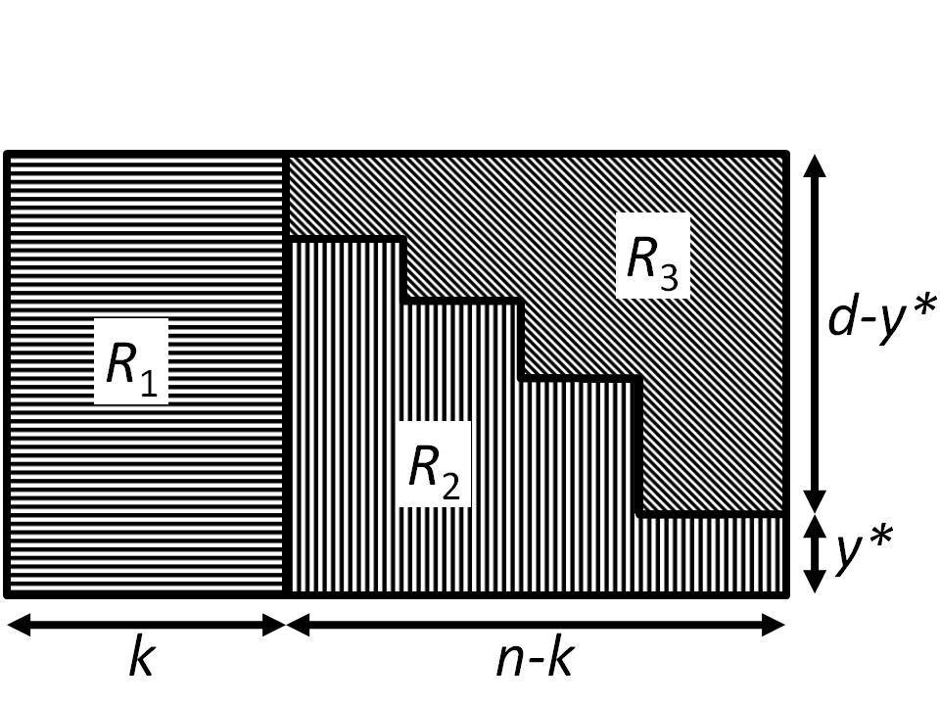
Result for Identity Freq. Caps and Equal Demands
Theorem
Consider advertisers of with unit frequency caps and equal values and demands. Any non-lazy algorithm is ¾-competitive.
Proof idea
Pay d/y*
Pay
y*/(d-y*)
Our Maximal Loss
Full advertisers
Minimal impressions per advertiser
Our Maximal Loss
Each impression of OPT-ALG gets:

Slide 14
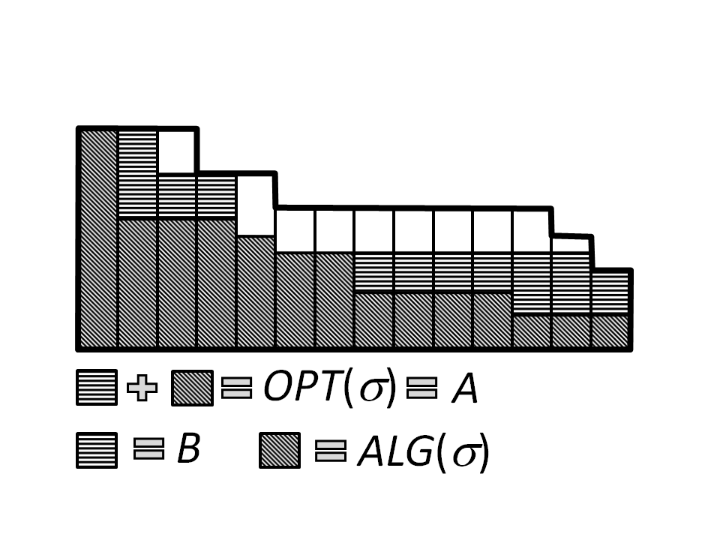
Result for Identical Values
Algorithm (3/4-competitive)
Sort the advertisers by demand.
Assign each impression to the first eligible advertiser.
Reduction
We can assume every advertiser is assigned by OPT more than by the algorithm.
Proof idea
Use flow arguments.

Slide 15
Result for Identical Values (cont.)
Notation
OPT_{j}(σ) – Number of impressions assigned by OPT to a_{i}.
y_{j} – Number of impressions assigned by the algorithm to a_{i}.
k_{j} – An indicator whether the algorithm exhausts the demand of a_{i}.
B – The impressions OPT assigned with no corresponding impression assigned by the algorithm.
Analysis Idea
Impressions of B assigned to advertiser a_{i} get paid from two sources:
Impressions of a_{i} pay them y_{i}/(d_{i}-y_{i}).
Impressions of full advertisers pay them d_{i}/y_{i}.

Slide 16
Result for Identical Values (cont.)
Difficulty
We got the same payments as before.
The difficulty is showing that the full advertisers can bear the cost.
Theorem
For every advertiser a_{i} which is not full:
Implication
Ties the number of B packets up to advertiser a_{i} with the number of full advertisers to the left of a_{i}.
Advertisers to the left of a_{i} have demand ≥ d_{i}.
Used to show that the full advertisers have enough revenue to invest in their payments.

Slide 17

General Case
Upper bound (of 0.707)
Two advertisers with unit frequency caps:
  a₁ – demand 2 and value 1.
  a₂ – demand 1 and value 2^{0.5}.
One impression of arrives.
Case 1
The configuration after the arrival:
No other impressions arrive.
Competitive ratio:
Case 2
The configuration after the arrival:
Two impressions of a new user arrive.
Competitive ratio:
a₁
a₂
a₁
a₂

Slide 18
General Case (cont.)
Dual Linear Program
A – The set of advertisers.
B – The set of users.
K(j) – The number of impressions of user j.
y(i, j, k) – Indicates advertiser a_{i} got the k^{th} impression of user j.

Slide 19
General Case (cont.)
Primal Linear Program
Algorithm
Upon arrival of impression k of user j:
Assign impression k to advertiser m₁.
For each advertiser , set: w(i, j) ← max{0, (v_{i} – x(i)) – (v_{m2} – x(m₂))}.
For each advertiser i ∈ S(j) – m₁, set: w(i, j) ← 0.
For each impression r ≤ k of user j, set: z(j, r) ← v_{m2} – x(m₂).
For advertiser m₁, x(m₁) ← x(m₁) (1 – 1/d_{i}) + v_{m1} /(cd₁)
S(j) – The set of advertisers not yet assigned an impression of j.
m₁, m₂ – the two advertisers maximizing v_{i} – x(i).

Slide 20
General Case (cont.)
Remarks
The constant c is (1 + 1/d_{min})^{dmin} - 1, where d_{min} is the minimal demand.
Competitive ratio, 1 – 1 / (c + 1), which approaches 1 – 1 / e for large demands.
The algorithm both increases and decreases primal variables.
  This is unlike other online primal-dual algorithms.
The algorithm can be easily made to work with user targeting.
  In this case its competitive ratio is tight.

Slide 21

Open Problems
Improving upon the 1-1/e competitive algorithm for general values and demands.
  The worst upper bound known is 0.707.
Supporting targeting constraints regarding both:
  User
  Context (webpage)
Improved approximation ratio for equal values and high demands.
  ¾ is known to be tight for low demands only.
  If all demands are equal and approach infinity, we have a 0.828-competitive algorithm.
Using randomization to bypass the deterministic upper bounds.

Slide 22
Questions
?

